Slide 1
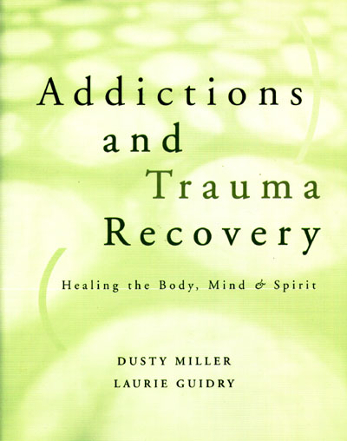
“ATRIUM”
A Addiction
T Trauma
R Recovery
I Integration
M Model

Slide 2



DMH

Slide 3

A group for people who want to heal…
Trauma and
Addiction
Notes:
We have had many different experiences with trauma and addiction - it shows up in different ways and behaviors for all of us
We focus on the IMPACT that the trauma and addiction has had on us

Slide 4

Seeking balance
Body
Mind
Spirit

Slide 5
Series of 9 Weekly Groups
Learn about stress and
finding balance
  Discuss how this new information is important to us. Not a discuss about past trauma
  Practice using drawing, writing, visual imagery and movement
Notes:
Understanding and validating our experiences - we are always seeking balance!!!

Slide 6
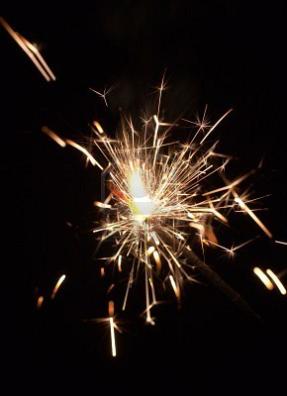


Learn to soothe: “charged” emotions

Slide 7
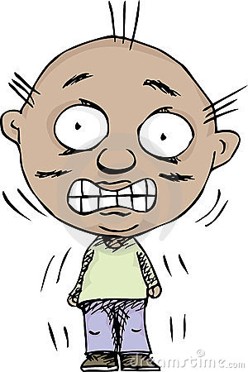
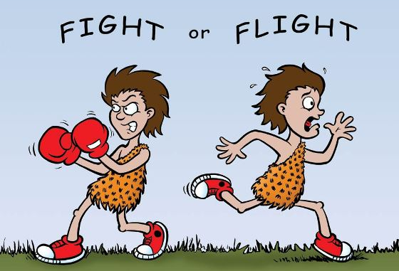
Understand Current Experiences
Notes:
Short term response – then another part of nervous system is activated and we return to balance (rest and renew)
If threat is always there, or we can not make sense of the event be become overwhelmed and our “flight or fight” response no longer works correctly - our system is out of balance – can no longer bring ourselves to “rest and renew”

Slide 8
Learn new information
and useful skills: self care

Slide 9

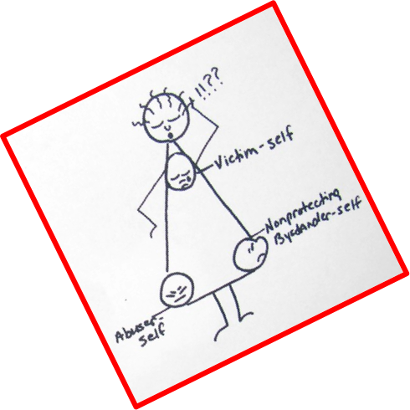

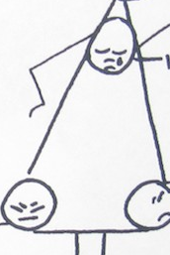
Abuser
Victim
“I’m SO UGLY!”
“Disgusting!”
“Poor me”
“I’m STUPID!”
“I’m worthless”
“I’m stupid”
“I don’t know”
“But…”
“I’m stupid…”
Non-protective
Bystander

Slide 10
ALWAYS…
trying to re-gain our balance

Slide 11
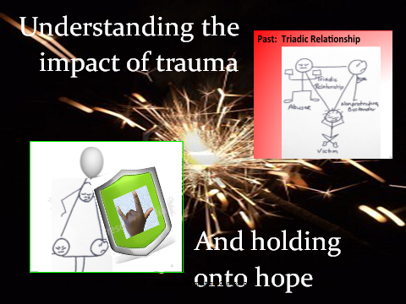
Build: Protective Presence

Slide 12

Explore
alternative healing skills

Slide 13
  Realize

